Slide 1
Cybersecurity Incidents per EU Country
Anna Kożuch, NatáLiA MIHOKOVá, Łukasz Siemieński

Slide 2
Why this topic?
Global average cost of data breach in 2025 is $4.4 million
You have less then 1 hour to stop an intrusion
Breaches keep you down for months
Email is still a multi-bilion-dolar drain (in 2024 $2.77 billion losses reported by U.S. Organizations)
Source: IBM, ic3.gov, crowdstrike.com, bakerdonelson.com

Slide 3

Do you want to be the part of these statistics in the future?

Slide 4
Questions we will try to answer
How will the losses look like in EU countries next year
What is the financial cost of a cyber incident and is it corelate with the amount of incidents
In which direction should you look first if you want to prevent future losses
Is there a corelation between GDP, population and the number of incidents per country

Slide 5
DROPPING NUMBER OF INCIDENTS DOES MEAN EVEN BIGGER LOSSES!

Slide 6
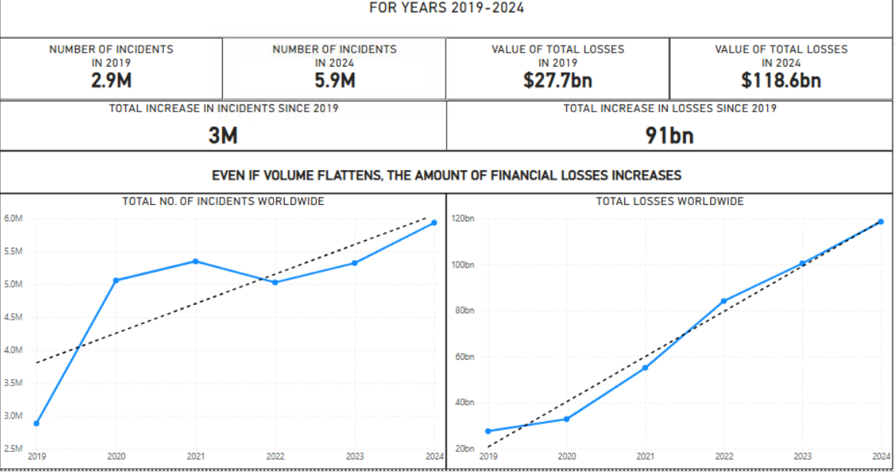

Slide 7
COSTS ARE RISING...
ON AVERAGE, EACH COUNTRY NEXT YEAR WILL FACE A LOSS OF APPROXIMATELY $2bln USD.

Slide 8
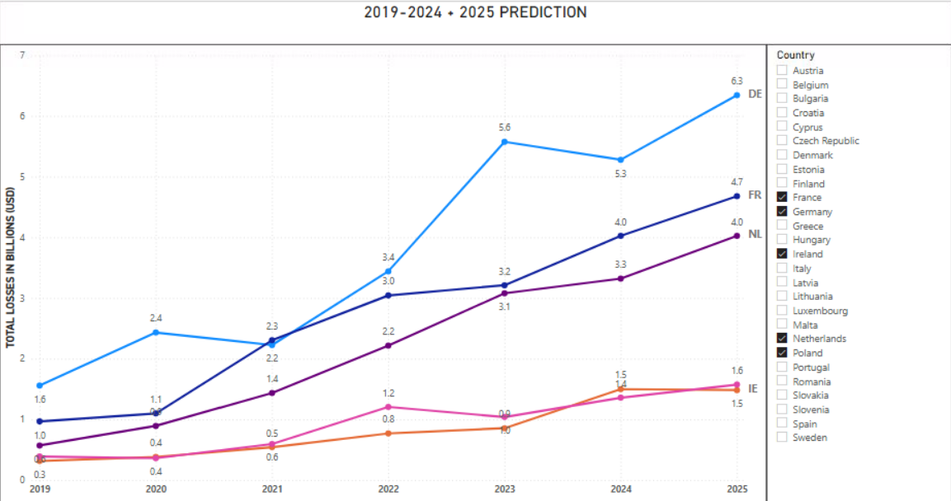

Slide 9
THESE LOSSES CAN BE AVOIDED!
EVEN A MODEST REDUCTION SAVES REAL MONEY, AND – FAST – EVEN THIS YEAR

Slide 10
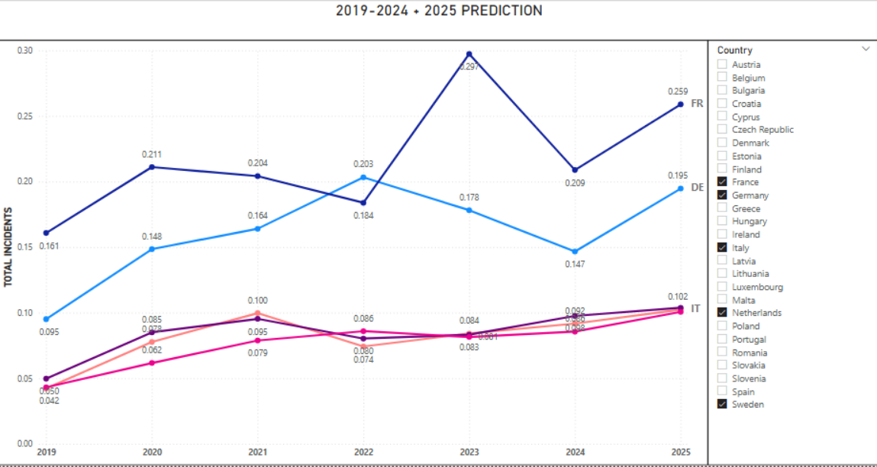

Slide 11
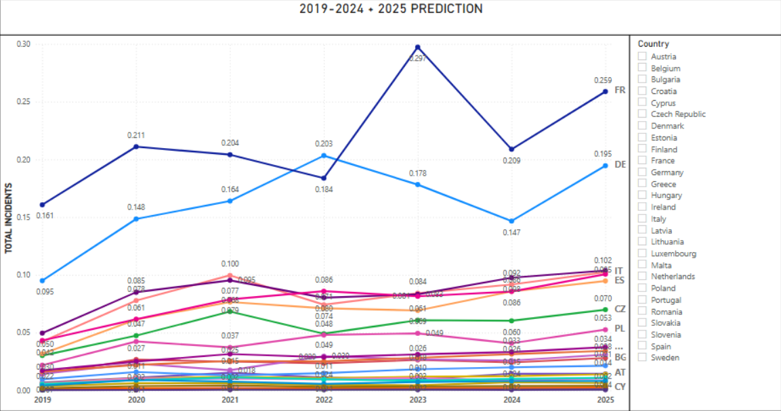

Slide 12
HOW MUCH CAN WE SAVE IF WE ACT NOW?
INVESTING INTO CYBERSECURITY AND DEFENSE MEANS 10-15% OF THE FINANCIAL LOSSES AVOIDED.
THAT IS BETWEEN $7bln to $10.5bln A YEAR.

Slide 13
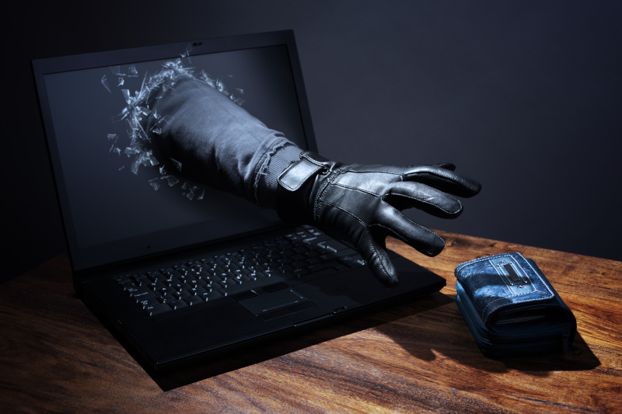
What can we do about it? We can be prepared!

Slide 14
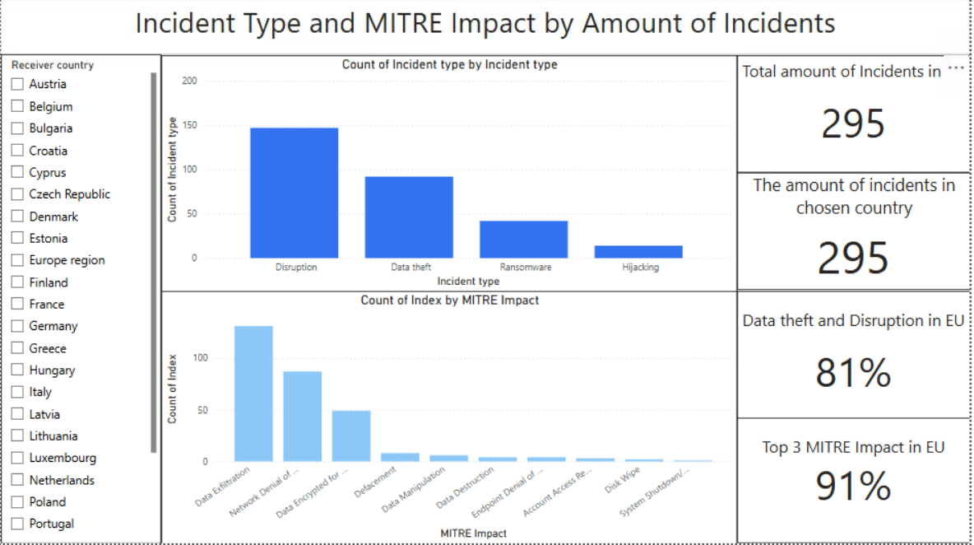
PowerBI

Slide 15
Data theft
Definition :
Someone breaks in and steals confidential information (e.g., customer data, ID numbers, HR files).
Real-life example:
OPM (US Office of Personnel Management), 2015 — attackers stole records for ~21.5 million people, including background-check forms and some fingerprints.
Effect: years of credit-monitoring costs, identity-theft risk for employees and their families, and long-term national-security exposure.
Source: U.S. Office of Personnel Management (OPM)

Slide 16
Data disruption
Definition:
An attack stops systems from working (services go down, operations halt), even if nothing is stolen.
Real-life Example:
Norsk Hydro (2019) - A ransomware attack (LockerGoga) shut down IT systems at the global aluminum producer, forcing plants to switch to manual operations or halt production while systems were rebuilt.
Effect:
Estimated business impact was around $70M, lost output, recovery costs, reputational stress).
Source: Nozomi Networks

Slide 17
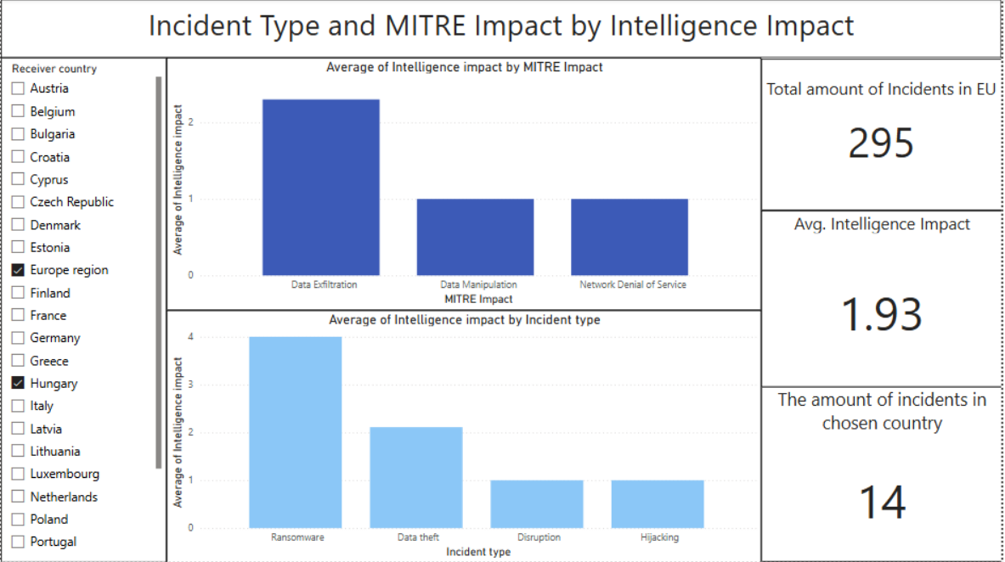
Results

Slide 18
Data Exfiltration
Definition:
Attackers move copied data out of the network to an external location. (MITRE “Exfiltration” tactic TA0010)
Example:
Equifax, 2017 — personal data of ~147 million people was stolen.
Effects: hundreds of millions in remediation and settlements, years of credit monitoring, major reputational harm.
Source: Federal Trade Commission (U.S)

Slide 19
Network Denial of Service
Definition:
Flooding networks or online services with fake traffic so legitimate users can’t get in.
Example:
Dyn DNS, 2016 (Mirai botnet) — massive DoS knocked out access to Twitter, Netflix, Spotify and others for many users in the US/EU.
Effects: brand damage for affected services, lost ad/sales revenue, incident-response costs
Source: The Guardian

Slide 20
Data Encrypted for Impact
Definition:
Malware encrypts files/systems so the business can’t use them, typically demanding payment. (MITRE ATT&CK T1486)
Example:
WannaCry, 2017 (NHS UK) — ransomware disrupted hospital IT, cancelling appointments and diverting ambulances; studies measured drops in admissions at affected hospitals.
Effects: care delays, patient-safety risk, recovery and resilience spend.
Source: PubMed Central

Slide 21
Does GDP define the number of cybersecurity incidents?
Cybersecurity incidents are rising

Slide 22
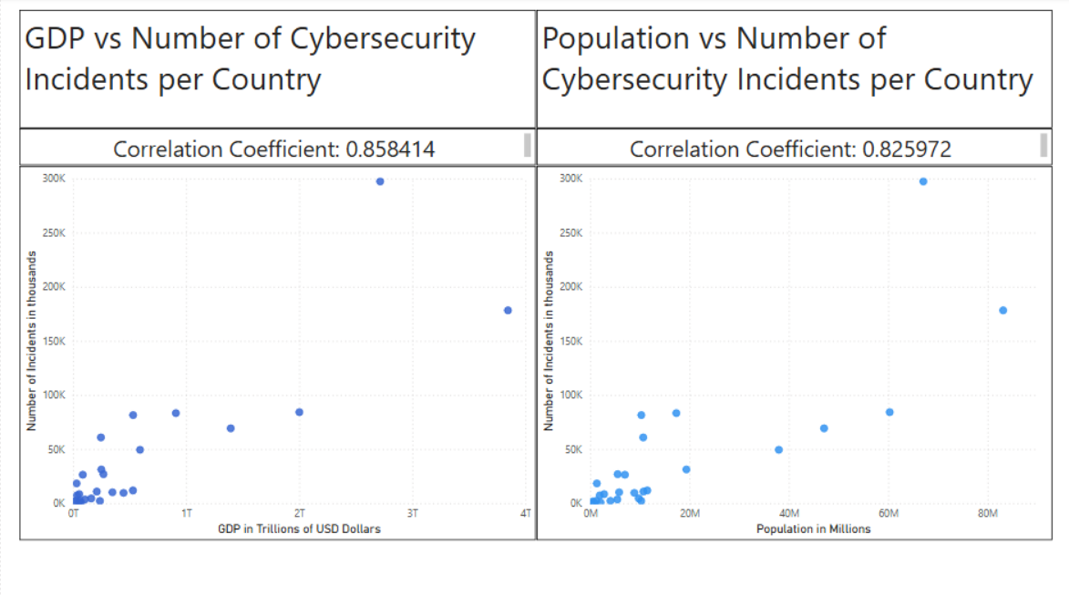

Slide 23
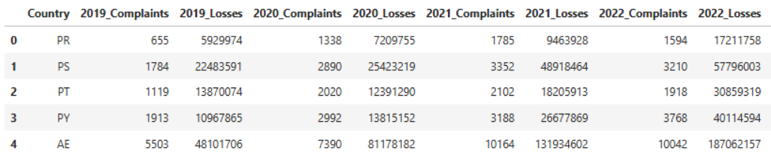
Data Used
1. Number of cyber incident and financial losses per country From 2019 – 2024
Table snippet
Source: kaggle

Slide 24
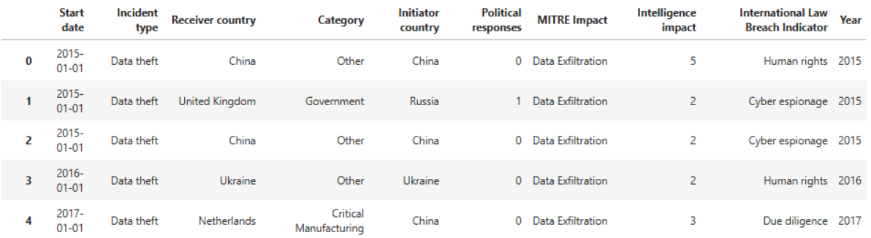
Data Used
2. Subset of individual cyber incidents
Table snippet
Source: Zenodo

Slide 25
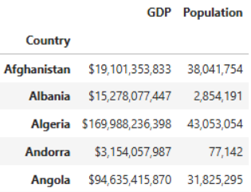
Data Used
3. Socioeconomic statistics data per country (used Population and GDP )
Table snippet
Source: kaggle

Slide 26
Key Takeaways:

